Slide 1
SSP v2024 Review Slides
2024-09-19

Slide 2
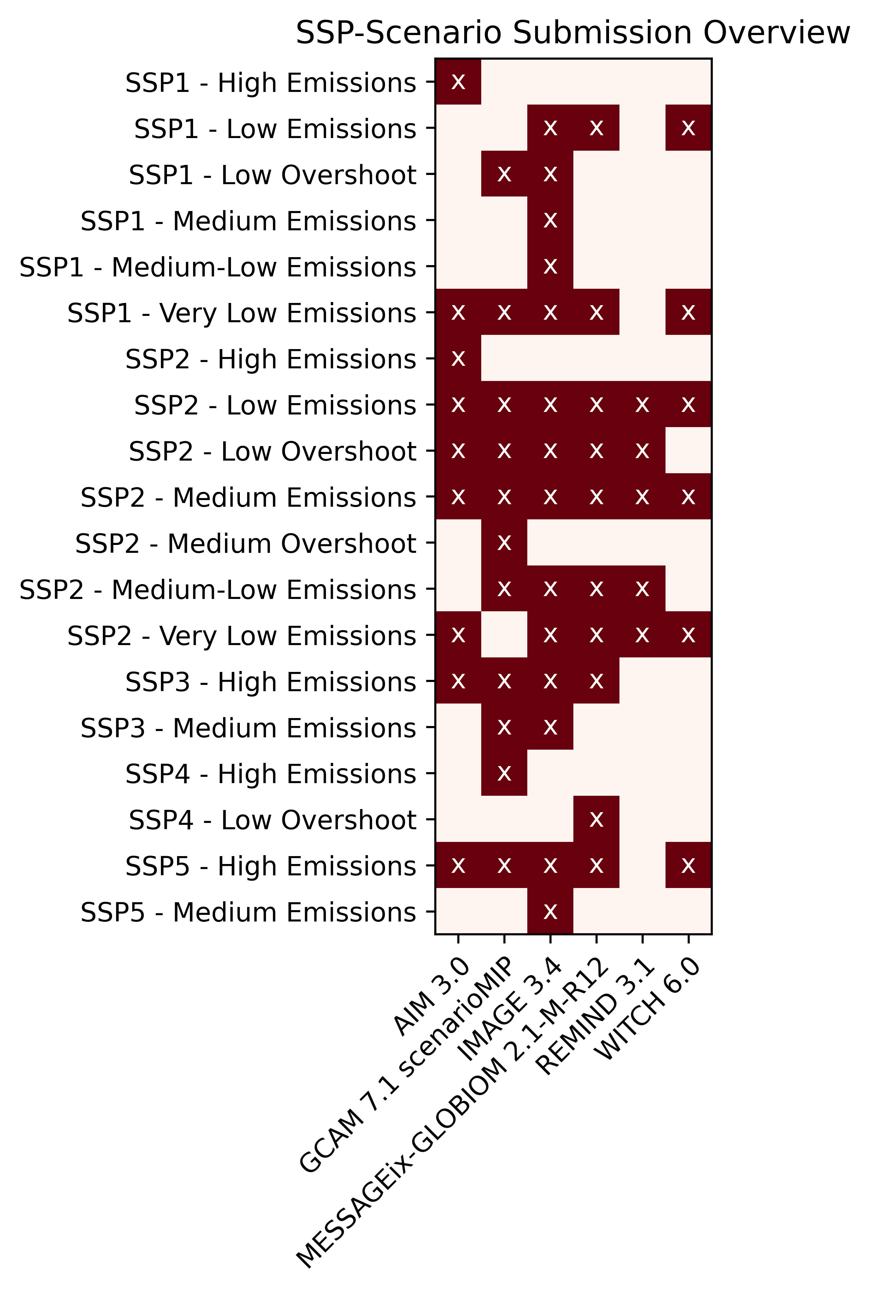

Slide 13
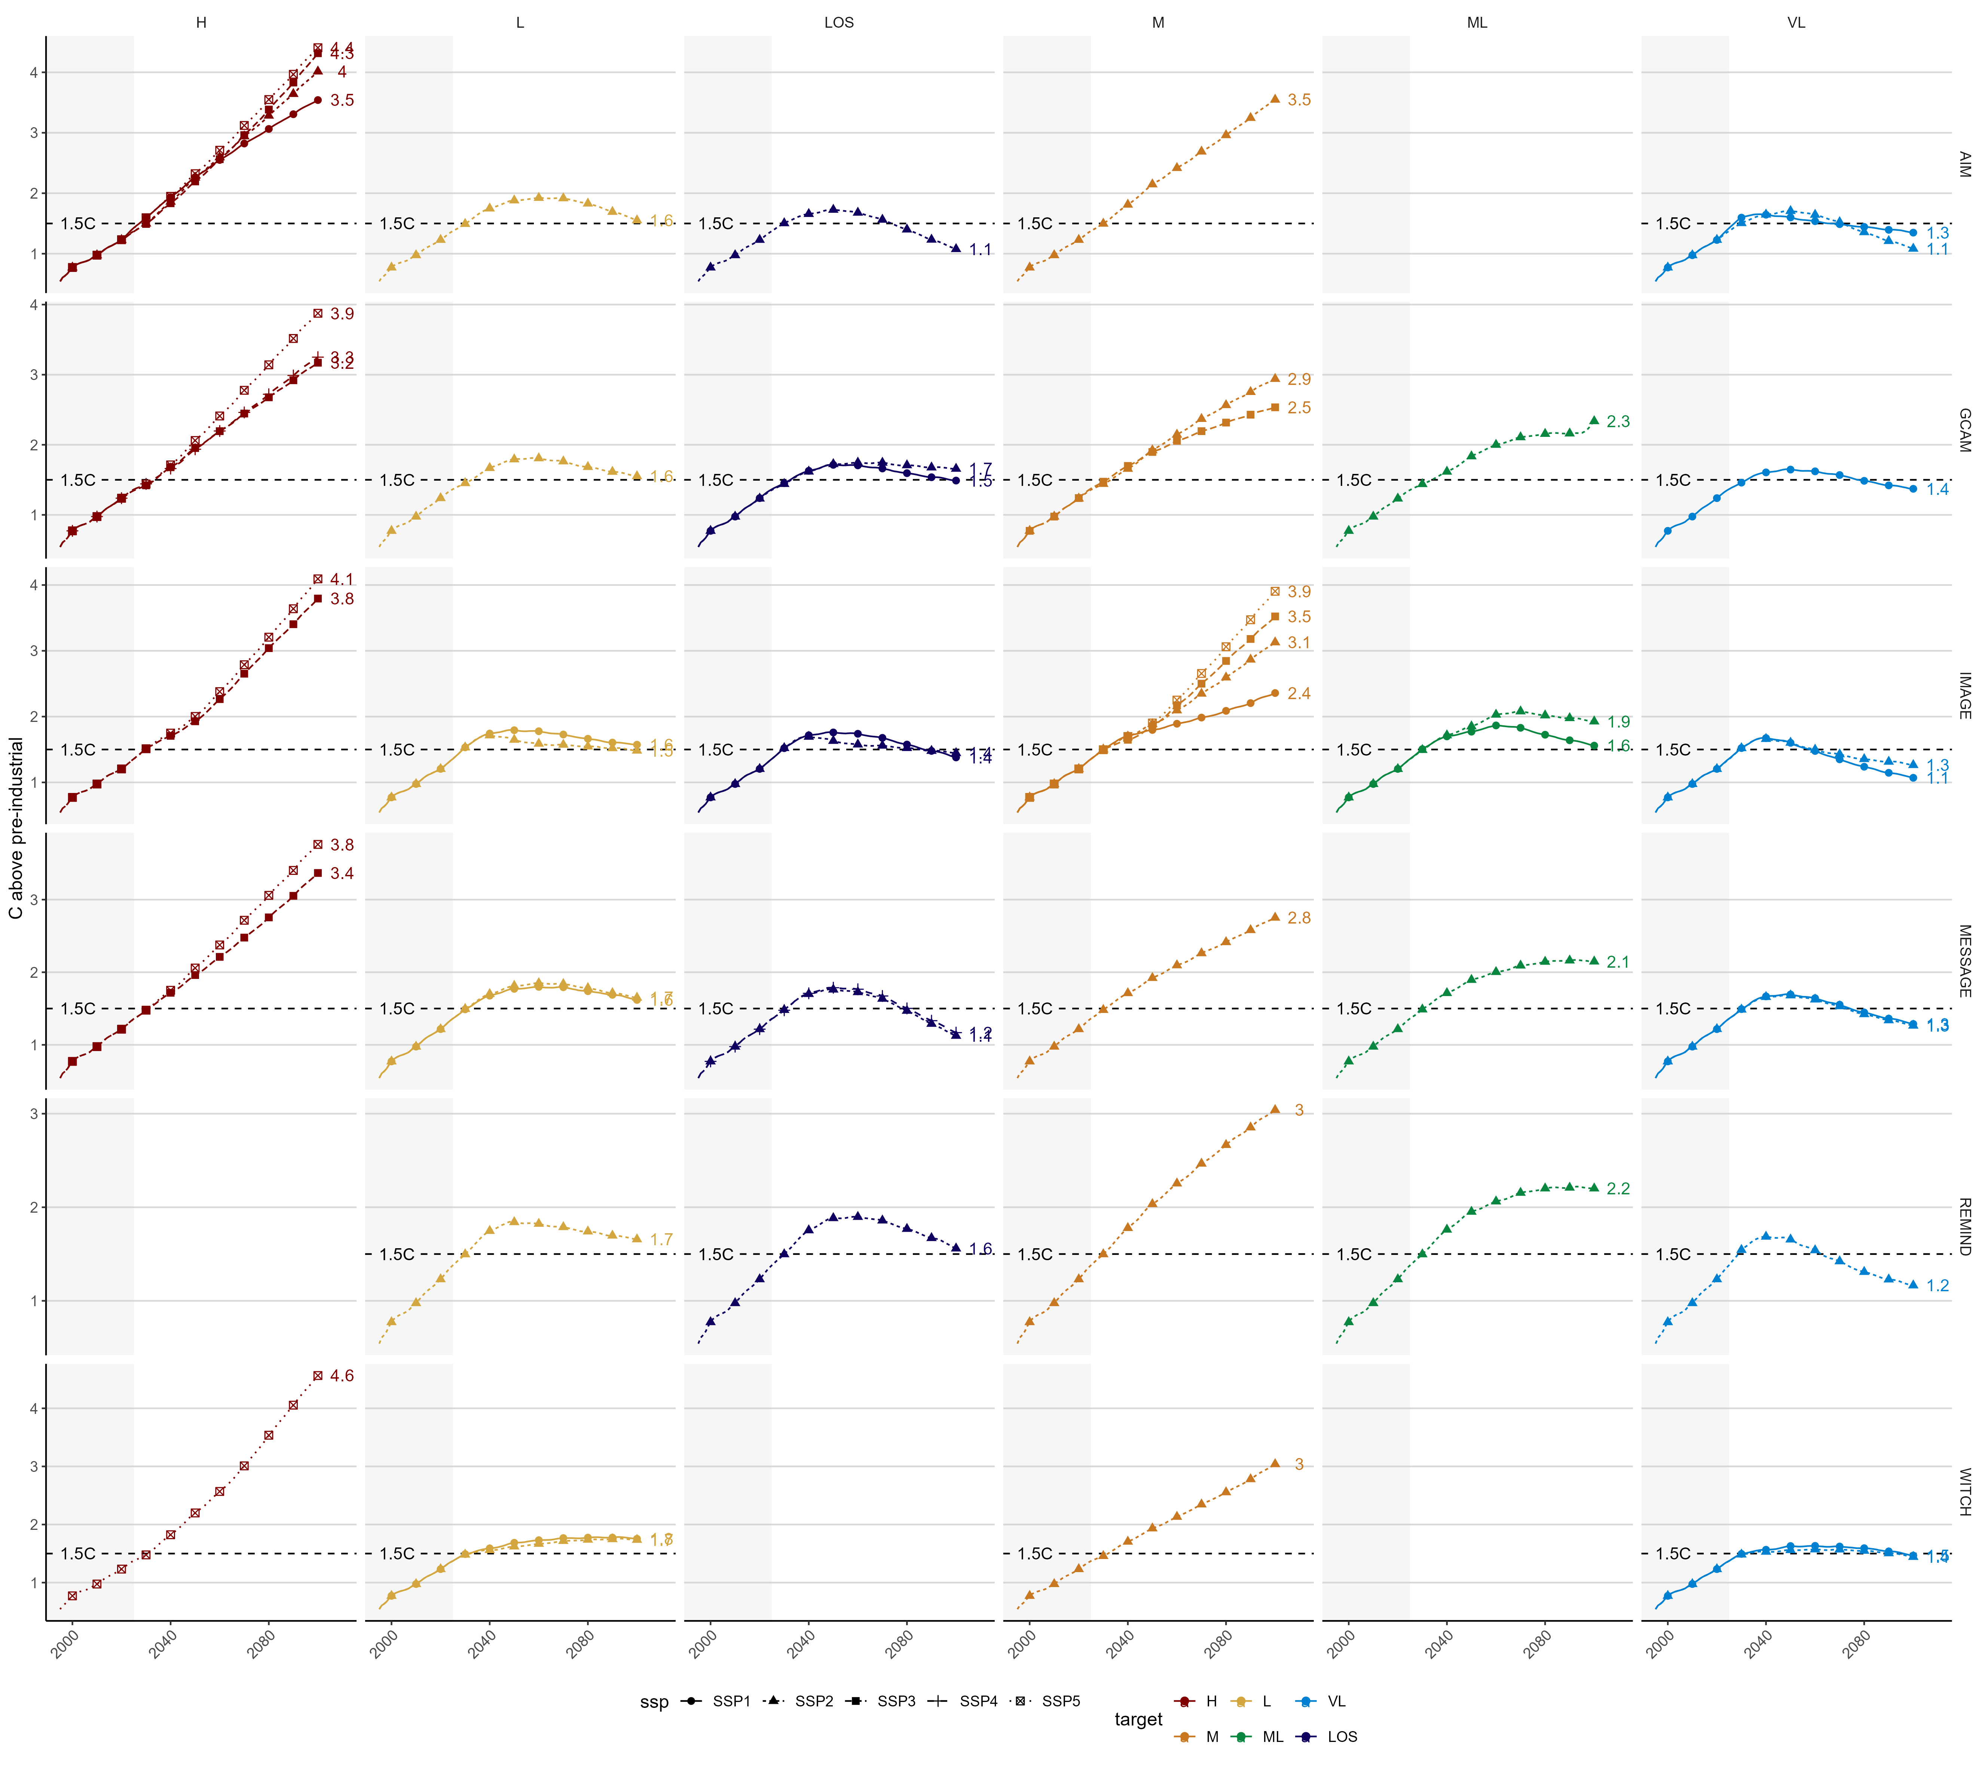

Slide 14
model | target | SSP1 | SSP2 | SSP4
AIM | VL | 1.65 | 1.71 | NA
AIM | L | NA | 1.92 | NA
AIM | LOS | NA | 1.73 | NA
GCAM | LOS | 1.71 | 1.75 | NA
GCAM | VL | 1.65 | NA | NA
GCAM | L | NA | 1.81 | NA
IMAGE | L | 1.80 | 1.72 | NA
IMAGE | LOS | 1.76 | 1.70 | NA
IMAGE | VL | 1.68 | 1.67 | NA
MESSAGE | L | 1.80 | 1.85 | NA
MESSAGE | VL | 1.70 | 1.69 | NA
MESSAGE | LOS | NA | 1.76 | 1.79
REMIND | L | NA | 1.85 | NA
REMIND | LOS | NA | 1.90 | NA
REMIND | VL | NA | 1.69 | NA
WITCH | L | 1.78 | 1.76 | NA
WITCH | VL | 1.63 | 1.57 | NA
target | Range of peak Temp options | model
VL | 1.57-1.71 | Across models and SSPs
L | 1.72-1.92 | Across models and SSPs
LOS | 1.70-1.90 | Across models and SSPs

Slide 15
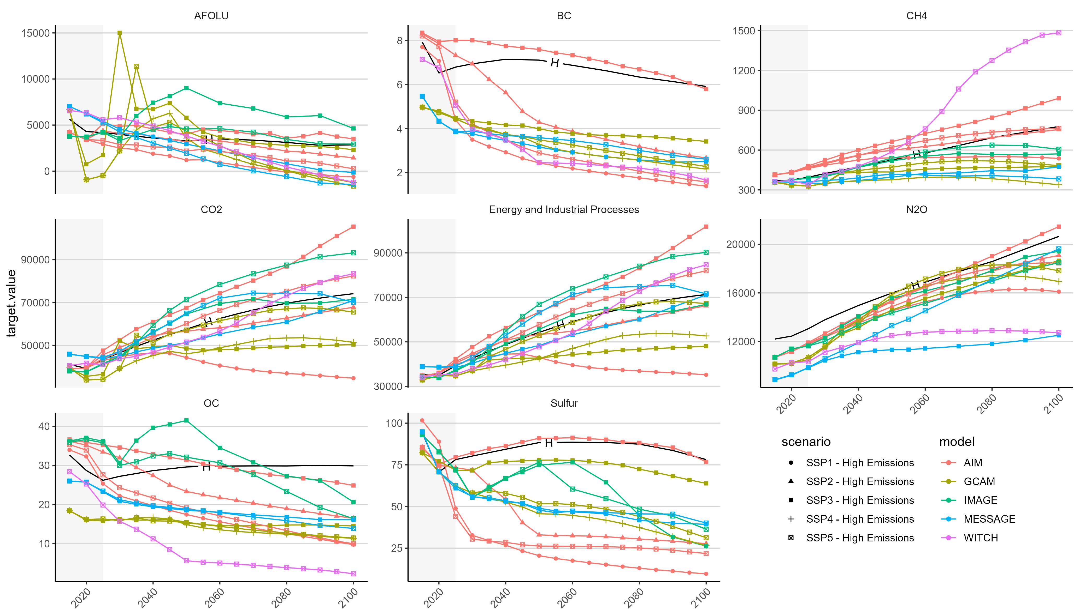

Slide 16
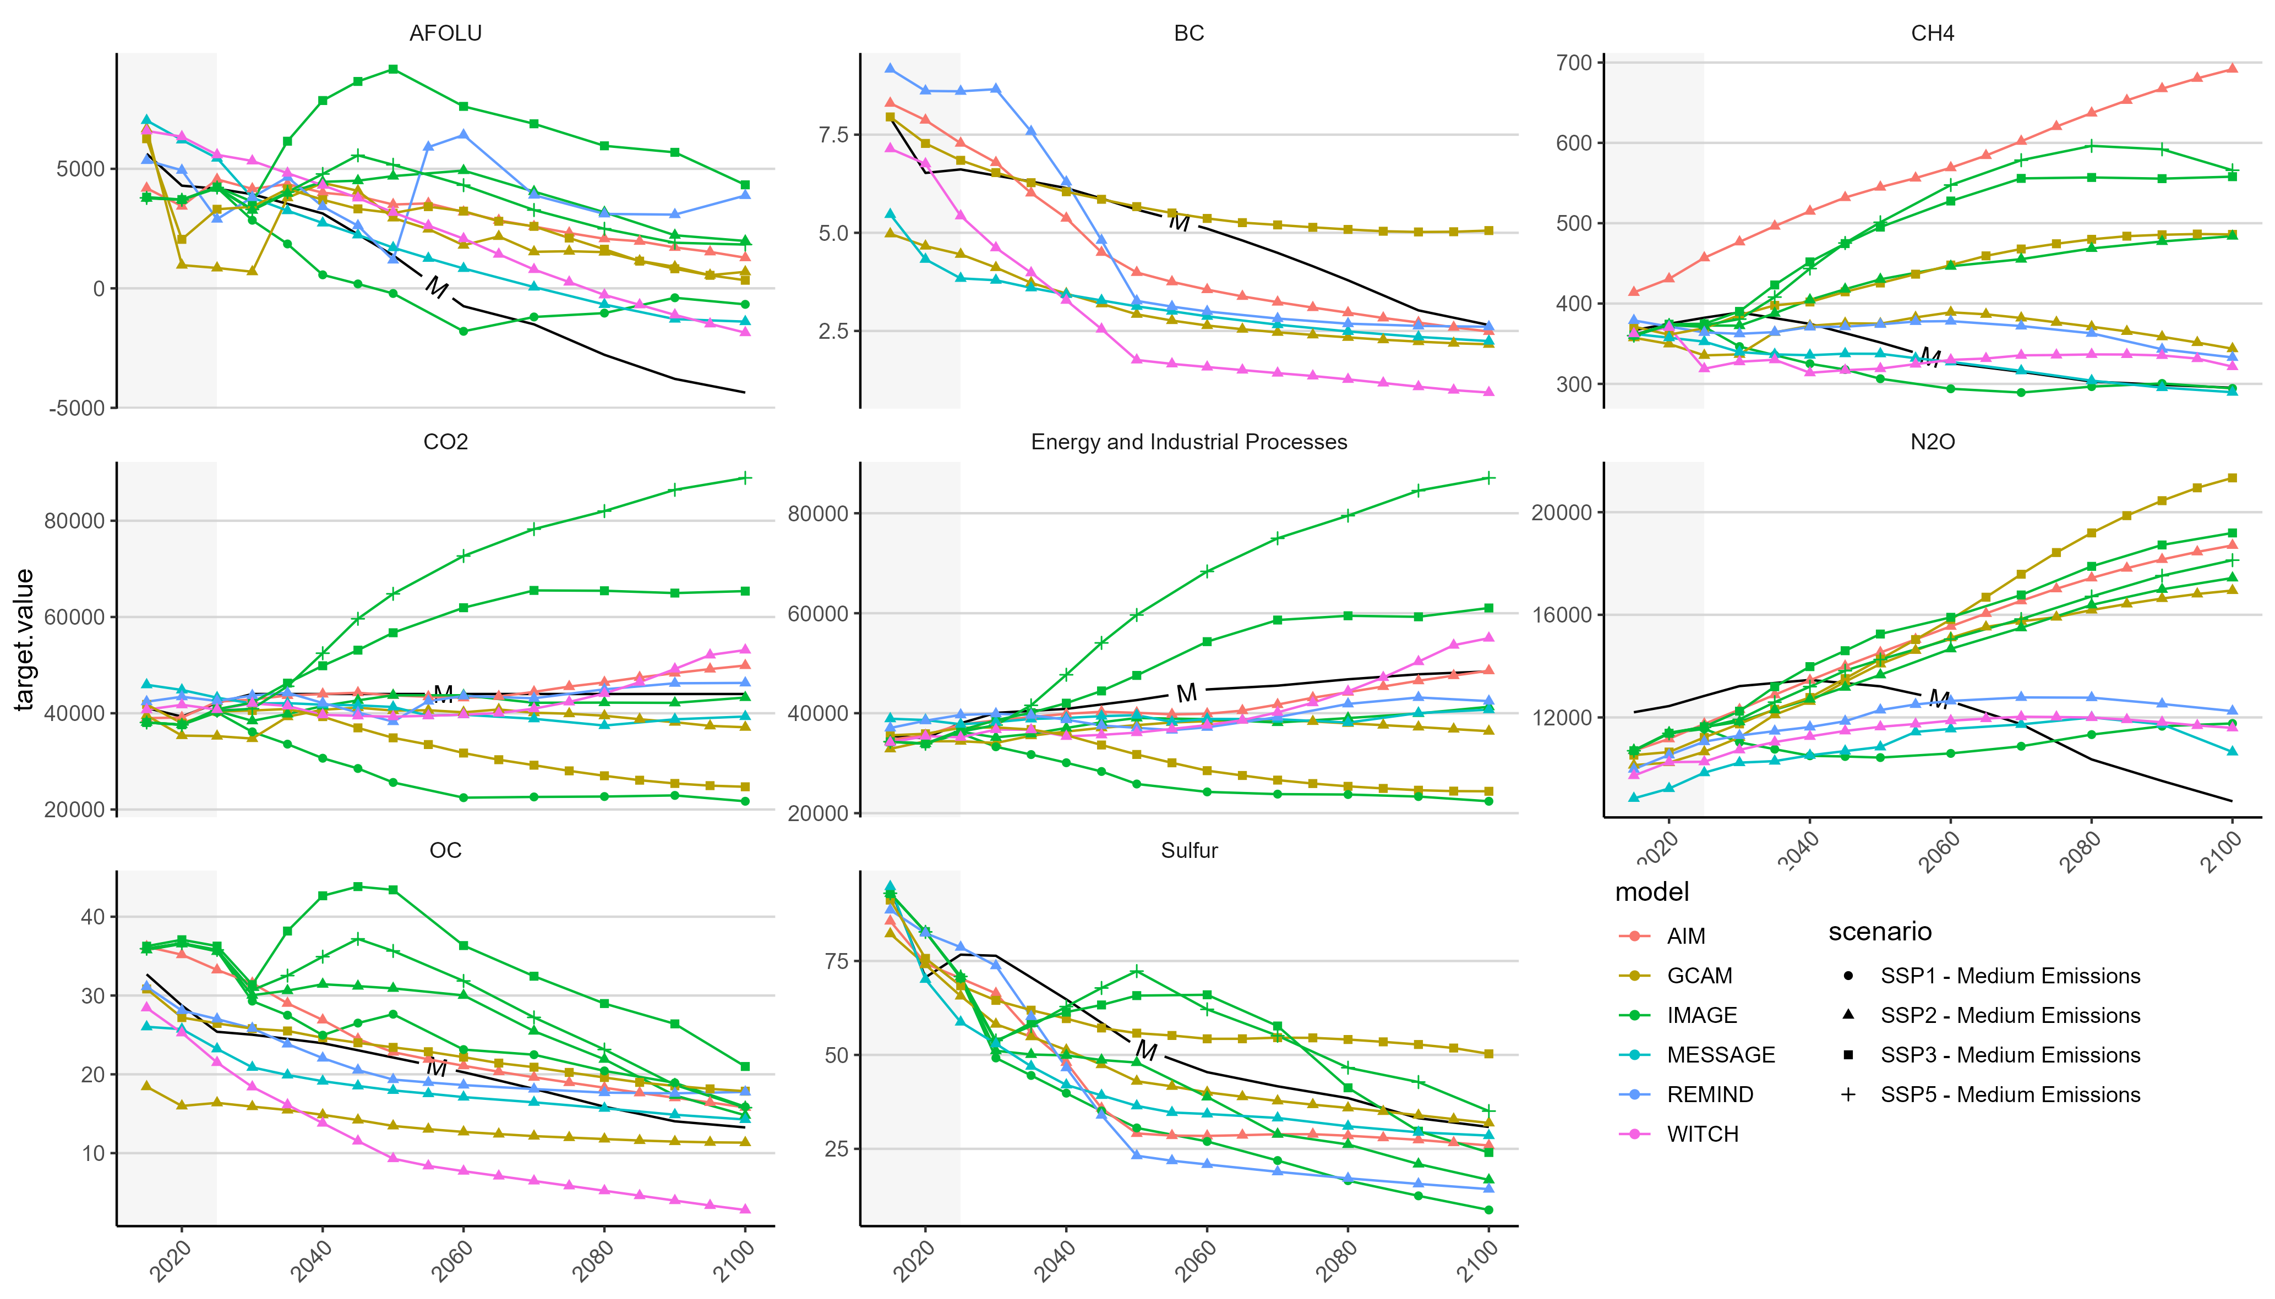

Slide 17
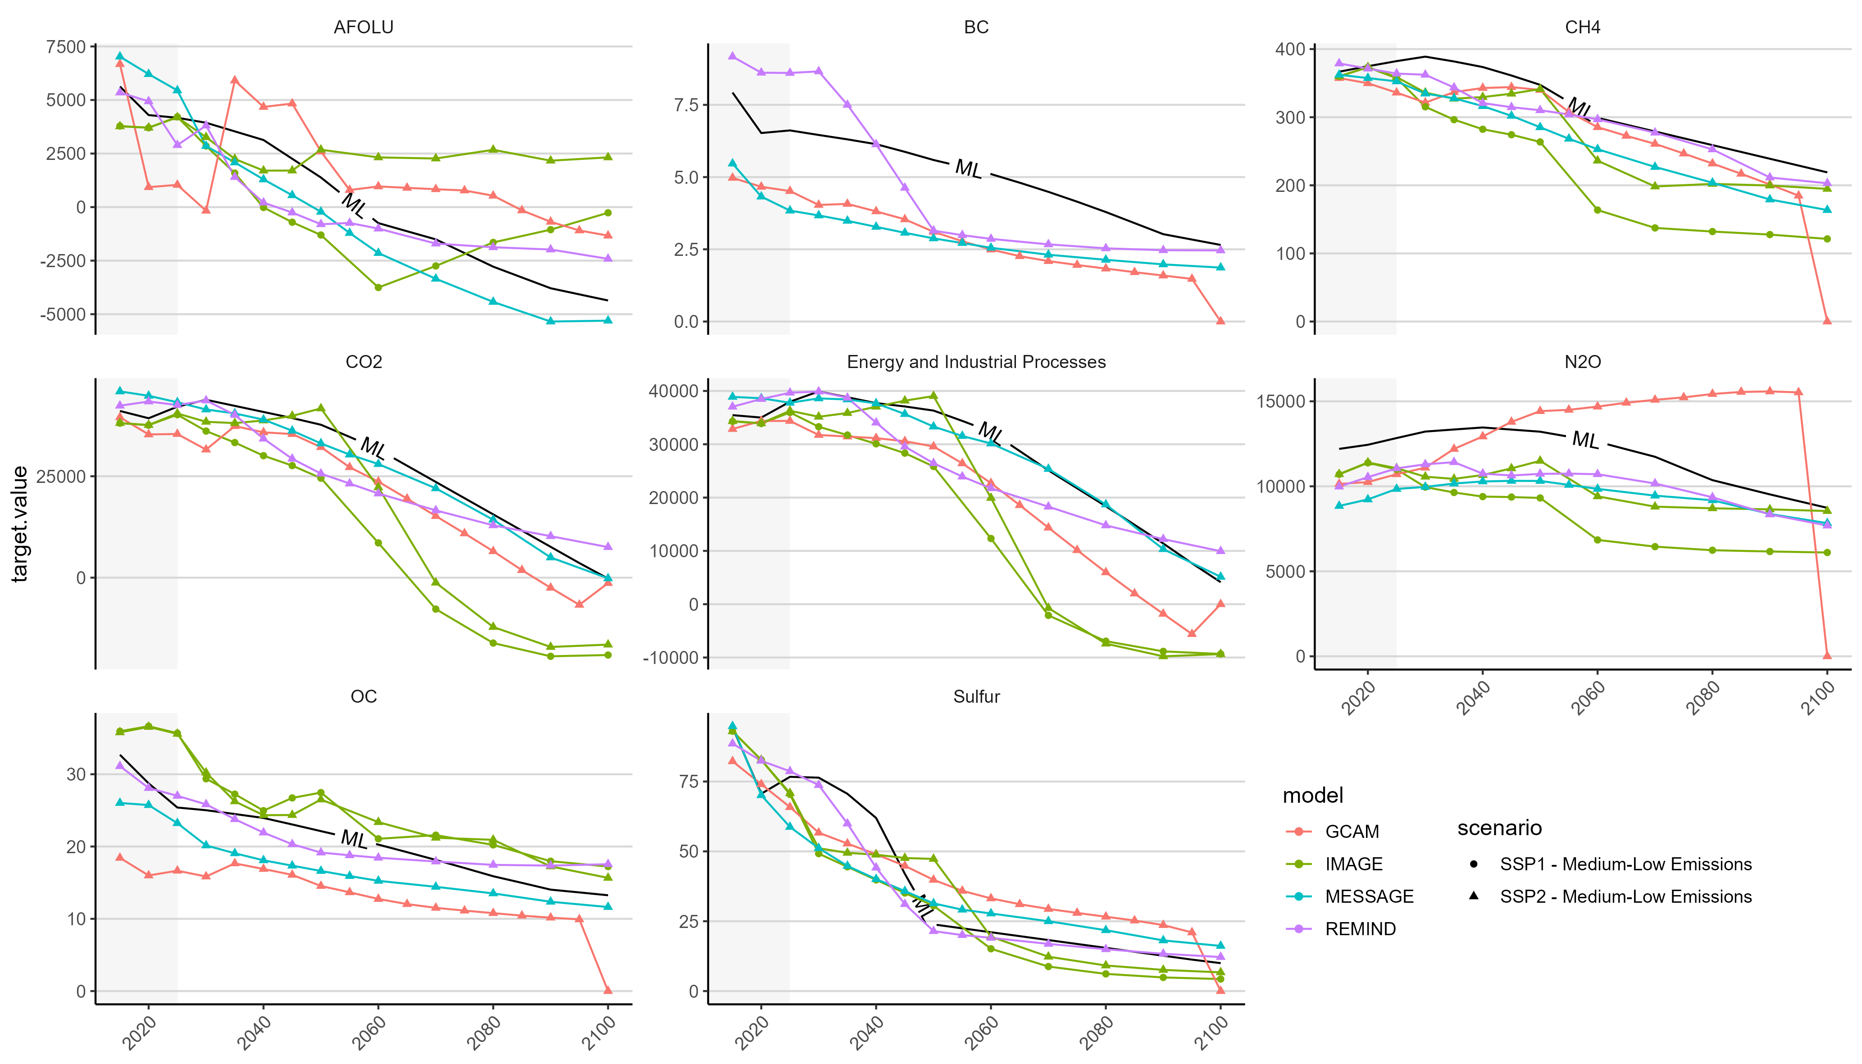

Slide 18
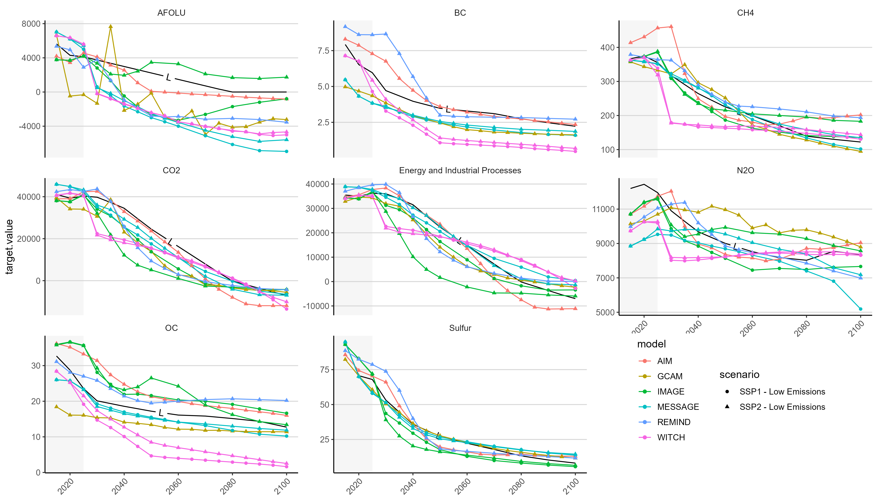

Slide 19
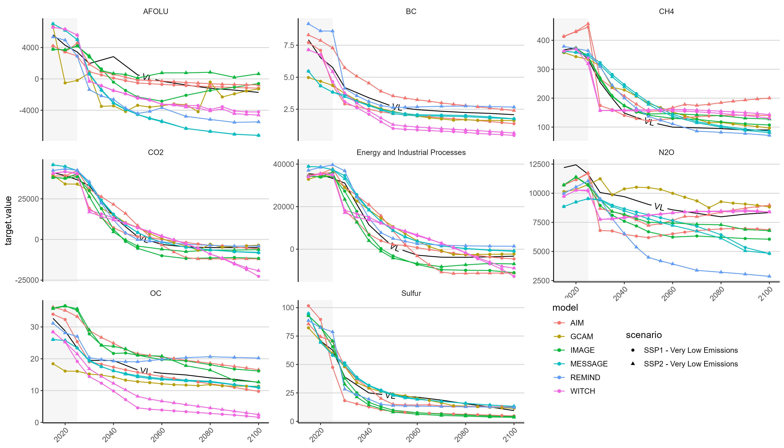

Slide 20
